Slide 1
Topic Name Comparison growth rate of Brinjal in Summer vs Winter Season
Submitted To:
Md. Irfan
Assistant professor
University Of Barishal
Submitted By:
Md.Riaj Hosen
Roll: 14

Slide 2
Introduction
Brinjal (Solanum melongena), also known as eggplant, is a popular vegetable grown across various climates worldwide. Its growth depends heavily on environmental factors such as temperature, humidity, and soil conditions. Seasonal variation, particularly the contrast between summer and winter, plays a significant role in the growth and yield of brinjal. This report examines the growth rate of brinjal plants during the summer and winter seasons, investigating how temperature, sunlight, and other climatic factors influence plant development.
Objective
The primary objective of this research is to compare the growth rates of brinjal in summer and winter seasons to determine the most favorable season for optimal growth and yield.

Slide 3
Methodology
This study was conducted in two distinct seasons: summer (March to June) and winter (November to February). The experiment was carried out in a controlled field setting to ensure uniformity of soil and water conditions. Key parameters measured included:
Temperature: Daily maximum and minimum temperatures were recorded.
Humidity: Average humidity levels were measured.
Soil Moisture: Soil moisture was monitored to ensure the same watering schedules in both seasons.
Plant Height: The height of the brinjal plants was measured weekly.
Leaf Area: The surface area of leaves was calculated as an indicator of photosynthesis efficiency.
Flowering Time: The number of days taken for flowering after planting.
Fruit Set and Yield: The number of fruits set and the weight of the fruits at harvest.

Slide 4
Result:
Day | Season | Growth stage | plant height | leaf count | stem diameter | Days to flowering | Fruit count | Fruit weight | Soil PH | watering frequency DAYS | Notes
1 | summer | Germination | 0 | 0 | 0 |  | 0 | 0 | 6.5 |  | seed planted
2 | summer | seedling | 1 | 1 | 1 |  | 0 | 0 | 6.5 | 7
3 | summer | seedling | 3 | 2 | 1.5 |  | 0 | 0 | 6.5 | 6 | Healthy growth
4 | summer | seedling | 5 | 4 | 2 |  | 0 | 0 | 6.5 | 6
5 | summer | vegetative | 8 | 5 | 2.5 |  | 0 | 0 | 6.5 | 5
6 | summer | vegetative | 10 | 6 | 3 |  | 0 | 0 | 6.5 | 5
7 | summer | vegetative | 12 | 7 | 3.5 |  | 0 | 0 | 6.5 | 4

Slide 5
8 | summer | pre-flowering | 15 | 8 | 4 |  | 0 | 0 | 6.5 | 4 | Buds visible
9 | summer | flowering | 18 | 10 | 5 | 40 | 0 | 0 | 6.5 | 3 | Flowers opening
10 | summer | Early fruting | 22 | 12 | 5.5 | 42 | 3 | 100 | 6.5 | 3 | Fruits setting
11 | summer | Fruiting | 25 | 14 | 6 | 44 | 5 | 200 | 6.5 | 3
12 | summer | late fruiting | 28 | 16 | 6.5 | 45 | 8 | 300 | 6.5 | 3
13 | summer | maturity | 30 | 18 | 7 | 46 | 10 | 400 | 6.5 | 3 | Final harves
14 | summer | senescence | 28 | 14 | 6 | 47 | 5 | 150 | 6.5 | 4 | leaves yellowing
15 | summer | senescence | 25 | 16 | 5 | 50 | 2 | 50 | 6.5 | 5 | Most leaves fallen

Slide 6
1 | winter | Germination | 0 | 0 | 0 |  | 0 | 0 | 6.5 | 7 | seeds planted
2 | winter | seedling | 0.5 | 1 | 0.5 |  | 0 | 0 | 6.5 | 7
3 | winter | seedling | 1.5 | 2 | 1 |  | 0 | 0 | 6.5 | 6 | Health growth
4 | winter | seedling | 3 | 4 | 1.5 |  | 0 | 0 | 6.5 | 6
5 | winter | vegetative | 5 | 5 | 2 |  | 0 | 0 | 6.5 | 5
6 | winter | vegetative | 7 | 6 | 2.5 |  | 0 | 0 | 6.5 | 5
7 | winter | vegetative | 10 | 7 | 3 |  | 0 | 0 | 6.5 | 4

Slide 7
8 | winter | pre-flowering | 12 | 8 | 3.5 |  | 0 | 0 | 6.5 | 4 | buds visible
9 | winter | flowering | 15 | 10 | 4 | 40 | 0 | 0 | 6.5 | 3 | Flowers opening
10 | winter | Early fruting | 18 | 12 | 4.5 | 42 | 2 | 50 | 6.5 | 3 | Fruits setting
11 | winter | Fruiting | 20 | 14 | 5 | 44 | 5 | 150 | 6.5 | 3
12 | winter | late fruiting | 22 | 18 | 5.5 | 45 | 8 | 250 | 6.5 | 3
13 | winter | maturity | 24 | 16 | 6 | 46 | 10 | 300 | 6.5 | 3 | Final harvest
14 | winter | senescence | 22 | 14 | 5.5 | 47 | 5 | 100 | 6.5 | 4 | leaves yellowing
15 | winter | senescence | 20 | 16 | 5 | 50 | 2 | 50 | 6.5 | 5 | Most leaves fallen

Slide 8
Discussion
The results indicate that the growth rate of brinjal is significantly influenced by seasonal variations in temperature. In the summer, higher temperatures facilitated faster growth and earlier flowering but also led to increased water stress and pest problems. Despite the higher yield, the plants were more susceptible to diseases, which could reduce the quality of the produce.
In the winter, while the cooler temperatures slowed growth and delayed flowering, the plants experienced fewer issues with pests and diseases. The lower yield in winter may be attributed to the slower growth rate and the longer time needed for the plants to mature.

Slide 9
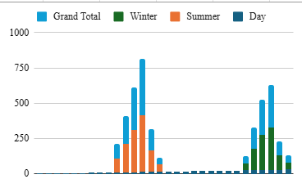

Slide 10
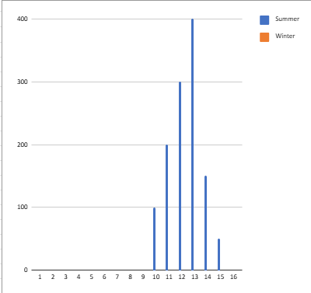

Slide 11
Conclusion
The summer season offers a faster growth rate and higher fruit yield for brinjal, albeit at the cost of increased water requirements and pest management challenges. The winter season, on the other hand, provides a more stable environment for the plants with reduced pest incidence, but the growth rate and yield are lower due to the cooler temperatures.
For optimal brinjal cultivation, summer appears to be the more favorable season, provided that farmers can manage water stress and pest issues. However, in regions with harsh summer climates, winter could still be a viable option for reduced maintenance and better fruit quality, albeit with lower yields.

